Slide 1
Orbis Technologies, Inc. OpenFDA 1.0 Storyboard 19 June 2015
Kojo Linder, PhD
Sr. Scientist
klinder@orbistechnologies.com
(410) 224-0951

Slide 2
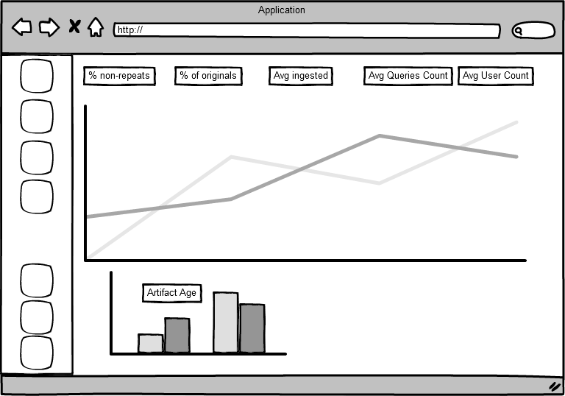
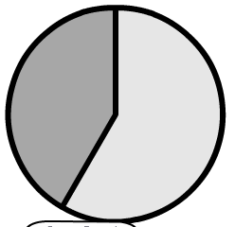
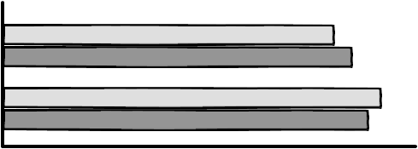
Homepage
Install Notes Release Notes Help Files
Wiley
2143
Total recalls
since 2004
518
US recalls
since 2004
24
Year-to-date recalls
3.7
Avg. Recalls per day
since 2004
+23%
Yearly change in recalls
Provides Executive level view
Quality
Search
150109 3.5
Monitor
Voluntary
Recall Type (1000s)
Zoom to certain data
FDA
150109 2.5
Classification
Recall status
Time
Class I
Ongoing
Terminated
1d 5d 1m 3m 6m 1y 5y 10y
Class III
Pending
Email
Letter
Blog
Forum
Completed
Notification Type
Ex
Class II
1m
Class II
Mouseover shows numeric values

Slide 3
Homepage
Install Notes Release Notes Help Files
Wiley
2143
Total recalls
since 2004
518
US recalls
since 2004
24
Year-to-date recalls
3.7
Avg. Recalls per day
since 2004
+23%
Yearly change in recalls
Quality
Quality
Search
150109 3.5
Monitor
Recall Type (1000s)
150109 2.5
Zoomed region
Classification
Recall status
Time
Class I
Ongoing
Terminated
1d 5d 1m 3m 6m 1y 5y 10y
Class III
Pending
Email
Letter
Blog
Forum
Completed
Notification Type
Ex
Ex
Class II
1m
Class II
Mouseover shows numeric values

Slide 4
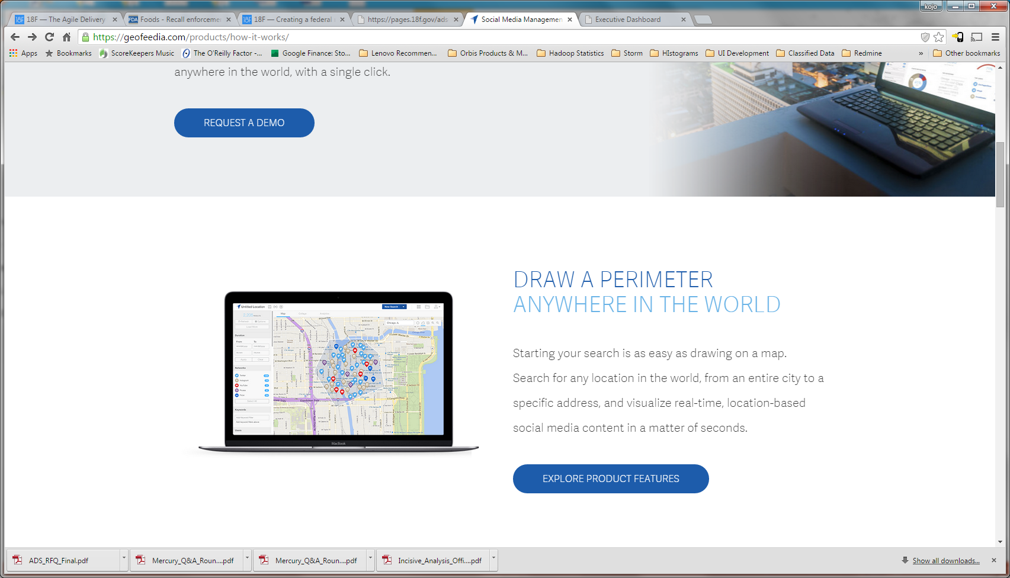
Search
User inputs search terms. User can also describe the search and utilize natural language processing for search results. Graphs and map change dynamically
Install Notes Release Notes Help Files
Wiley
2143
Ongoing recalls
518
US recalls
24
Year-to-date recalls
3.7
Avg. Recalls per day
+23%
Yearly change in recalls
%
Non repeat docs
%
Original docs
Avg. # of docs ingested per day
xx
Avg. User Count per day
%
Source accuracy
518
Ongoing FDA recalls
245
Recakks
Avg. # of Artifacts ingested per day
Quality
Quality
Search
Trends
Trends
Keyword Search
Timeline slider
Report date range
Location (state)
Food description
Search
User selects Map
Users
150109 3.5
Users
Monitor
Content
Content
Load
Save
Found 57 results
150109 2.5
Report Date: June 2015
Location :MD
Food description: corn
The search results
Time
Save
Save
Report Date: June 2015
Location :ND
Food description: corn
1d 5d 1m 3m 6m 1y 5y
Query Recall counts
Lo
Email
Letter
Blog
Forum
Lo
Notification Type
Report Date: June 2015
Location :ME
Food description: corn
Sources
Ex
Ex
Class II
Food Description

Slide 5
Search - hover
User inputs search terms. User can also describe the search and utilize natural language processing for search results. Graphs and map change dynamically
Install Notes Release Notes Help Files
Wiley
2143
Ongoing recalls
518
US recalls
24
Year-to-date recalls
3.7
Avg. Recalls per day
+23%
Yearly change in recalls
%
Non repeat docs
%
Original docs
Avg. # of docs ingested per day
xx
Avg. User Count per day
%
Source accuracy
518
Ongoing FDA recalls
245
Recakks
Avg. # of Artifacts ingested per day
Quality
Quality
Search
Trends
Trends
Keyword Search
status": "Ongoing",
"product_quantity": "81 containers",
"recall_initiation_date": "20120720",
"state": "ND",
"event_id": "62644",
"product_type": "Food",
"product_description": "Cass-Clay , Swiss Chip, 3 Gallon(11.34 L).“
, "country": "US",
"city": "Fargo",
"recalling_firm": "Cass Clay Creamery AMPI Fargo Division",
"report_date": "20120905",
"voluntary_mandated": "Voluntary: Firm Initiated“
, "classification": "Class II",
"initial_firm_notification": "Two or more of the following: Email,
Timeline slider
Report date range
Location (state)
Food description
Search
User selects Map
Users
150109 3.5
Users
Monitor
Content
Hover displays remaining metadata
Content
Save
Found 57 results
150109 2.5
Report Date: June 2015
Location :MD
Food description: corn
The search results
Time
Save
Save
Report Date: June 2015
Location :ND
Food description: corn
1d 5d 1m 3m 6m 1y 5y
Query Recall counts
Lo
Email
Letter
Blog
Forum
Lo
Notification Type
Report Date: June 2015
Location :ME
Food description: corn
Sources
Ex
Ex
Class II
Food Description

Slide 6
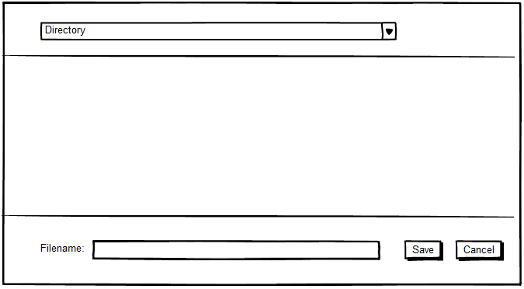
Search - Save
User inputs search terms. User can also describe the search and utilize natural language processing for search results. Graphs and map change dynamically
Install Notes Release Notes Help Files
Wiley
2143
Ongoing recalls
518
US recalls
24
Year-to-date recalls
3.7
Avg. Recalls per day
+23%
Yearly change in recalls
%
Non repeat docs
%
Original docs
Avg. # of docs ingested per day
xx
Avg. User Count per day
%
Source accuracy
518
Ongoing FDA recalls
245
Recakks
Avg. # of Artifacts ingested per day
Quality
Quality
Search
Trends
Trends
Keyword Search
Timeline slider
Report date range
Location (state)
Food description
Search
User selects Map
Users
150109 3.5
Users
Monitor
Content
Content
Save
Found 57 results
150109 2.5
Report Date: June 2015
Location :MD
Food description: corn
The search results
Time
Save
Save
Report Date: June 2015
Location :ND
Food description: corn
1d 5d 1m 3m 6m 1y 5y
Query Recall counts
Lo
Email
Letter
Blog
Forum
Lo
Notification Type
Report Date: June 2015
Location :ME
Food description: corn
Sources
Ex
Ex
Class II
Food Description

Slide 7
Monitor
Install Notes Release Notes Help Files
Wiley
2143
Total Queries
Since June 2015
518
Query time (ms)
24
Year-to-date queries
3.7
Avg. Queries per day
+23%
Yearly change in queries
Quality
Search
Top 10 queries
Monitors user queries
150109 3.5
Monitor
Queries
150109 2.5
Query count (1000s)
Ex
Time

